Slide 1

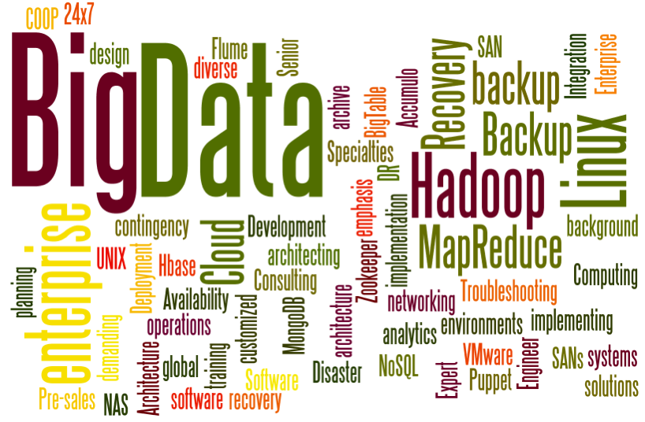
CSCI-E63
Big
Data
Analytics
CSCIE63 Section
10 – Claudio Bustamante

Slide 2

CSCI-E63, Section 10, 11-12-2017
Learning
Objectives
…
1
Introduction
2
TensorFlow Concepts
3
HW 10 Review
4
Final Project - Diane

Slide 3
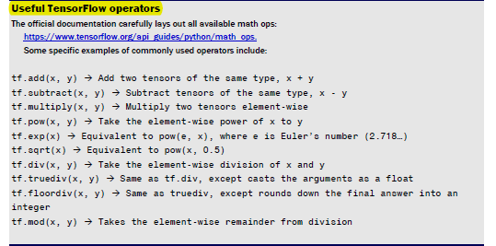
TensorFlow Operators
https://www.tensorflow.org/api_docs/
https://www.tensorflow.org/install/install_java - created a simple example

Slide 4

TensorFlow

Slide 5
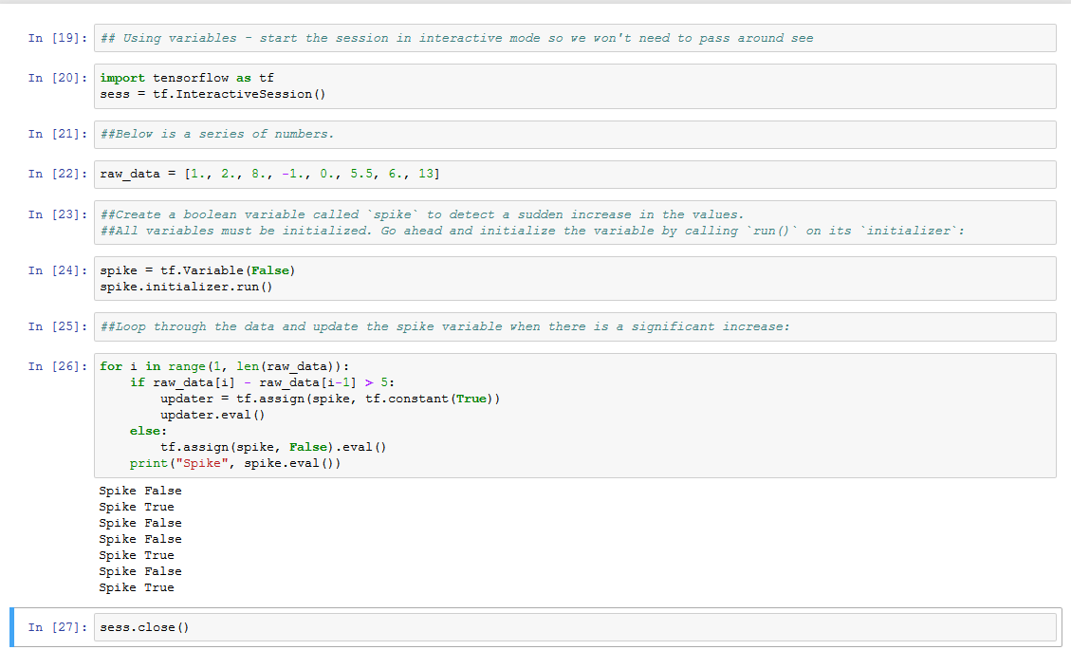
Organize Graphs – Variables.py
The code in listing is a simple TensorFlow program that demonstrates how to use variables. It updates a variable whenever sequential data abruptly increases in value. Think about recording measurements of a neuron's activity over time. This piece of code can detect
when the neuron’s activity suddenly spikes

Slide 6
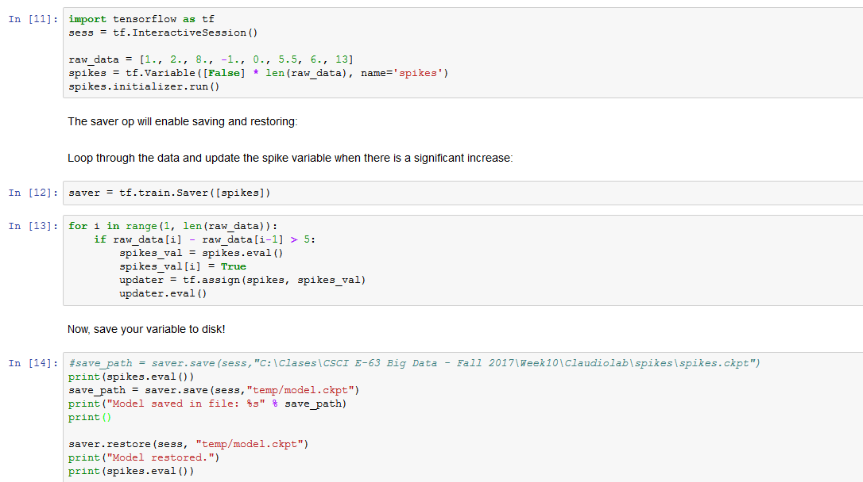
Organize Graphs – SavingRestoringVariables.py
You will notice a couple files generated, one of them being spikes.ckpt, in the same directory as your source code. It is a compactly stored binary file, so you cannot easily modify it with a text editor.
To retrieve this data, you can use the restore function from the saver op, as demonstrated
In complicated machine learning situations, saving and loading data at known checkpoints makes it much easier to debug code. TensorFlow provides an elegant interface to save and load variable values to disk. I’m going to show you how to use it for that purpose

Slide 7
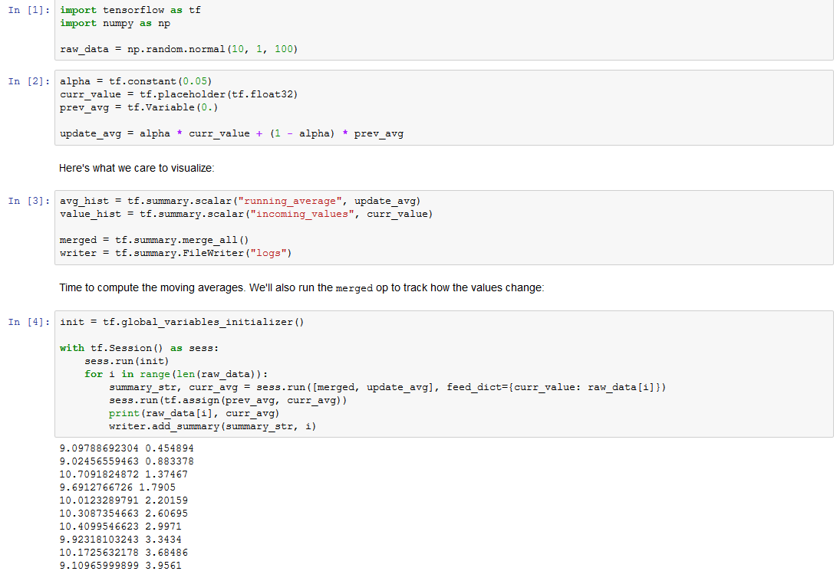
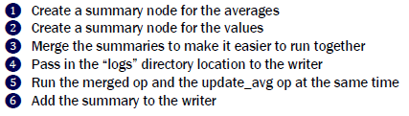
Organize Graphs – ScalarTensorBoard.py
Create a vector of 100 numbers with a mean of 10 and standard deviation of 1. Define alpha as a constant. A placeholder is just like a variable, but the value is injected from the session. Initialize the previous average to zero. Loop through the data one-by-one to update the average
https://docs.scipy.org/doc/numpy1.13.0/reference/generated/numpy.random.normal.html

Slide 8
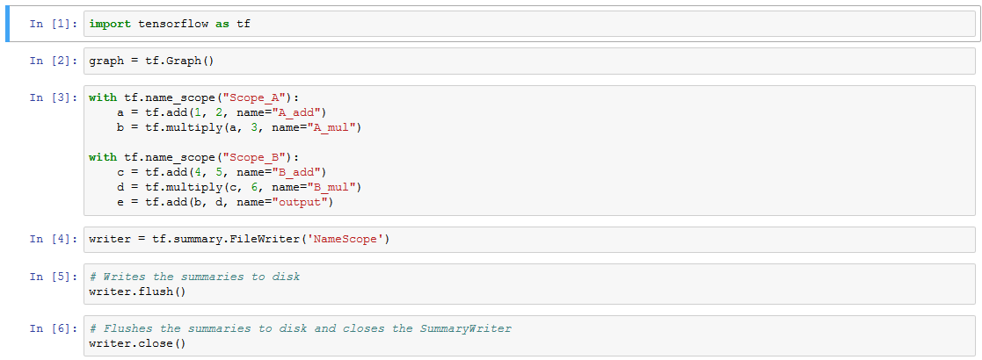
Organize Graphs – NameScope.py
Name scopes allow you to group Operations into larger, named blocks. Then, when you launch your graph with TensorBoard, each name scope will encapsulate its own operations, making the visualization much more digestible
Run: Python NameScope.py
tensorboard --logdir=NameScope
or tensorboard --logdir .

Slide 9
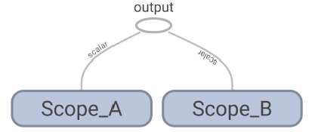
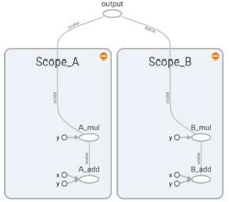
Organize Graphs – Name Scope
You’ll notice that the add and multiply Operations we added to the graph aren’t immediately visible. Instead, we see their enclosing name scopes. You can expand the name scope boxes by clicking on the plus + icon in their upper right corner.
Inside of each scope, you’ll see the individual Operations you’ve added to the graph.
When we visit TensorBoard Transformations shows first.

Slide 10
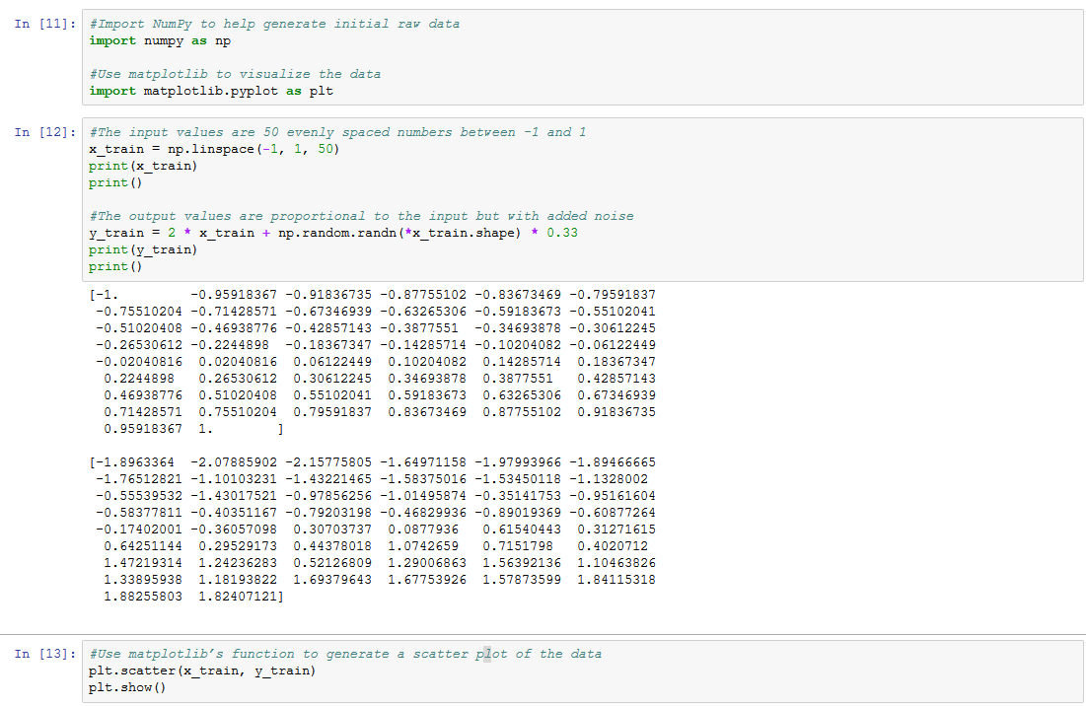
Organize Graphs – BasicRegression.py

Slide 11
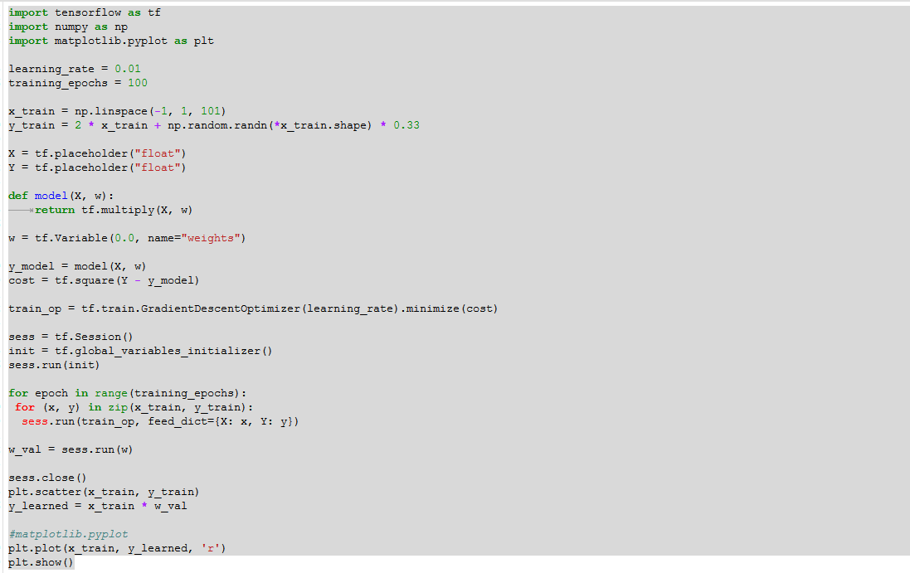
Organize Graphs – LinearRegression.py
Imagine plotting the correlation between rainfall frequency and agriculture production. You may observe that an increase in rainfall produces an increase in agriculture rate.
Fitting a line to these data points enables you to make predictions about the agriculture rate under different rain conditions.
If you discover the underlying function from a few data points, then that learned function empowers you to make predictions about the values of unseen data.

Slide 12
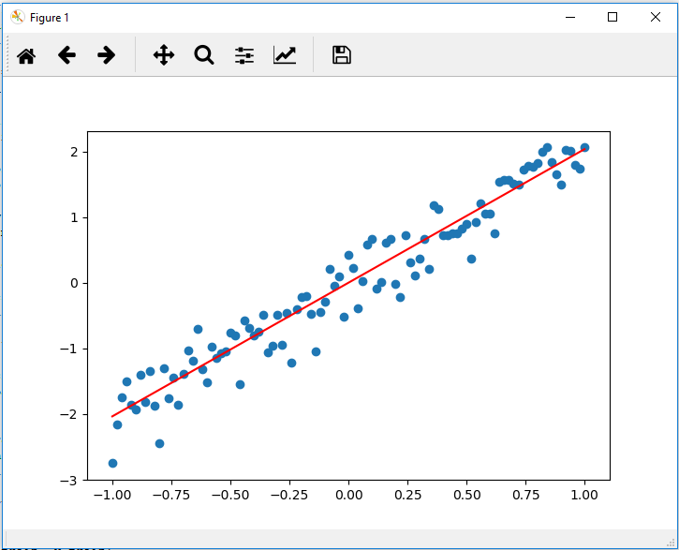
Organize Graphs – LinearRegression.py (Continuation)
Regression is a study of how to best fit a curve to summarize your data. It is one of the most powerful and well-studied types of supervised learning algorithms.
In regression, we try to understand the data points by discovering the curve that might have generated them. In doing so, we seek an explanation for why the given data is scattered the way it is.
The best fit curve gives us a model for explaining how the dataset might have been produced.
Run: python LinearRegression.py

Slide 13
Mathematical Statistics Functions – StDeviation.py
https://docs.python.org/3/library/statistics.html

Slide 14
Homework 10 review

Slide 15
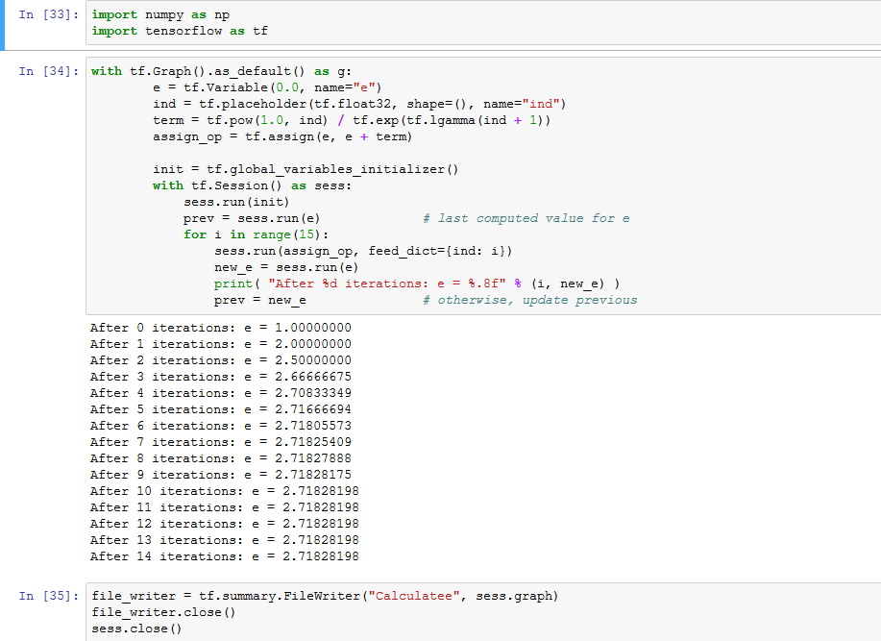
Problem 3 - Calculate_e
Determine the value of number e = 2.7183… to 6 decimal places using Taylor expansion. Export the TensorBoard graph of your process. Perform similar calculation using expression for e as $\lim_{n → ∞}{{(1+ \frac{1}{n})}^{n}}$.

Slide 16
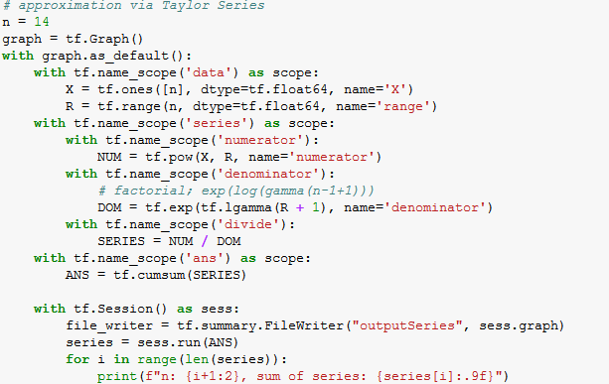
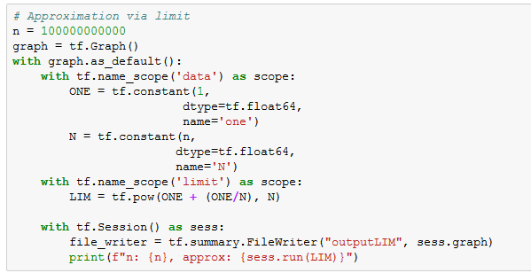
Problem 3 - Prob3
Determine the value of number e = 2.7183… to 6 decimal places using Taylor expansion. Export the TensorBoard graph of your process. Perform similar calculation using expression for e as $\lim_{n → ∞}{{(1+ \frac{1}{n})}^{n}}$.

